Slide 1



SMART INDIA HACKATHON 2026
TECH TIDE </>
  Problem Statement ID – SIH26040
  Problem Statement Title- Smart Water Purification and Quality Monitoring System for Rural and Mining-Affected Areas.
  Theme- Clean & Green Technology
  PS Category- Hardware
  Team ID-
  Team Name (Registered on portal)- Tech Tide </>

Slide 2

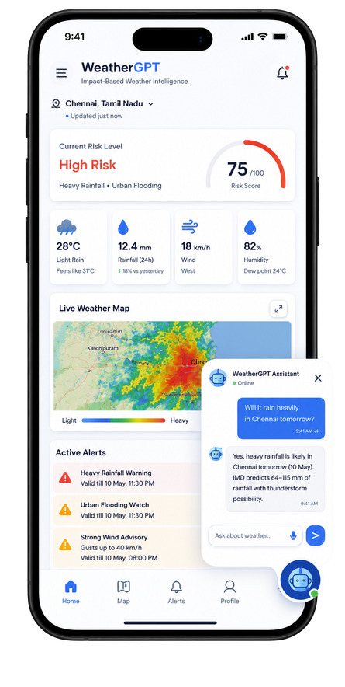
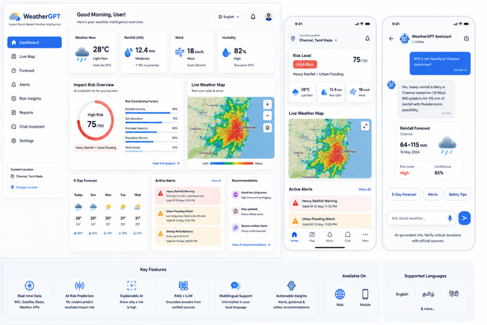
IoT-Based Real-Time Water Quality Detection, Treatment & Alert System
The Problem
Idea / Solution
Water quality varies significantly: Conventional purification systems may not detect changing water-quality conditions in real time.
  Invisible contamination risk: Users may receive water without knowing whether key quality parameters are within acceptable limits.
  No closed-loop response: Existing systems generally separate quality monitoring, treatment and user alerts, limiting timely intervention.
Real-Time Monitoring: pH, TDS, turbidity & temperature
Jharkhand-Specific Module: Local contaminants → targeted treatment
Smart Control: ESP32 + pump + valves
Multi-Stage Treatment: Filtration + UV
Quality Re-check: Post-treatment verification
Reject & Alert: Unsafe water → divert + alert
Innovation / Uniqueness
Proposed Solution
Closed-Loop Purification
Sense → Treat → Re-check → Deliver/Reject
Real-Time Automation
Treatment & water flow based on sensor readings.
Safety-Based Rejection
Unsafe water → Auto-divert + Alert
Integrated Monitoring
Sensors + Treatment + Alerts + Data Logging
(in one system).
Our system integrates real-time water quality sensing, intelligent treatment control and user alerts into a single closed-loop platform.
Sensors continuously monitor water quality → ESP32/controller analyses the readings → filtration/disinfection stages are activated as required → water is re-tested before being classified as acceptable.
2

Slide 3
TECHNICAL APPROACH
Your Team Name
  Technologies to be used (e.g. programming languages, frameworks, hardware)
  Methodology and process for implementation (Flow Charts/Images/ working prototype)
@SIH Idea submission- Template
3
Notes:
3

Slide 4
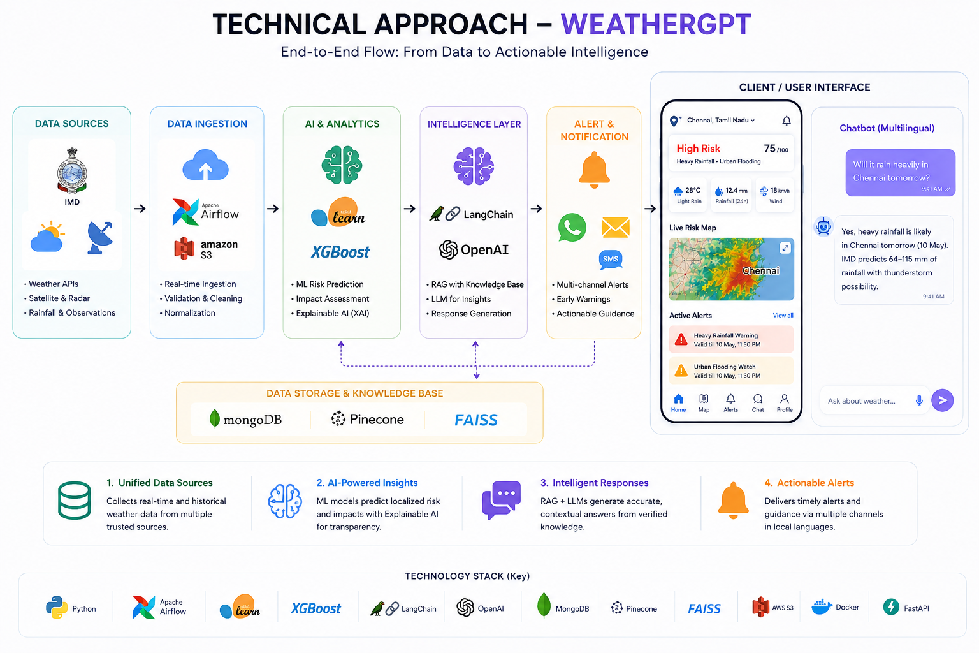

TECHNICAL APPROACH
TECHNICAL APPROACH
  DATA → AI RISK IMD/Weather APIs + satellite/radar + historical data → real-time ingestion → ML-based localized hazard & impact prediction with Explainable AI (XAI).
  RISK → INTELLIGENCE RAG knowledge base + Large Language Model (LLM) combines predicted risk with verified weather bulletins/advisories to generate contextual, trustworthy responses.
  INTELLIGENCE → ACTION Live dashboard + multilingual location-aware chatbot + alerts deliver risk maps, explainable warnings and actionable guidance to citizens and authorities.
@SIH Idea submission- Template
3
Notes:
3

Slide 5
FEASIBILITY AND VIABILITY
Your Team Name
  Analysis of the feasibility of the idea
  Potential challenges and risks
  Strategies for overcoming these challenges
@SIH Idea submission- Template
4
Notes:
4

Slide 6
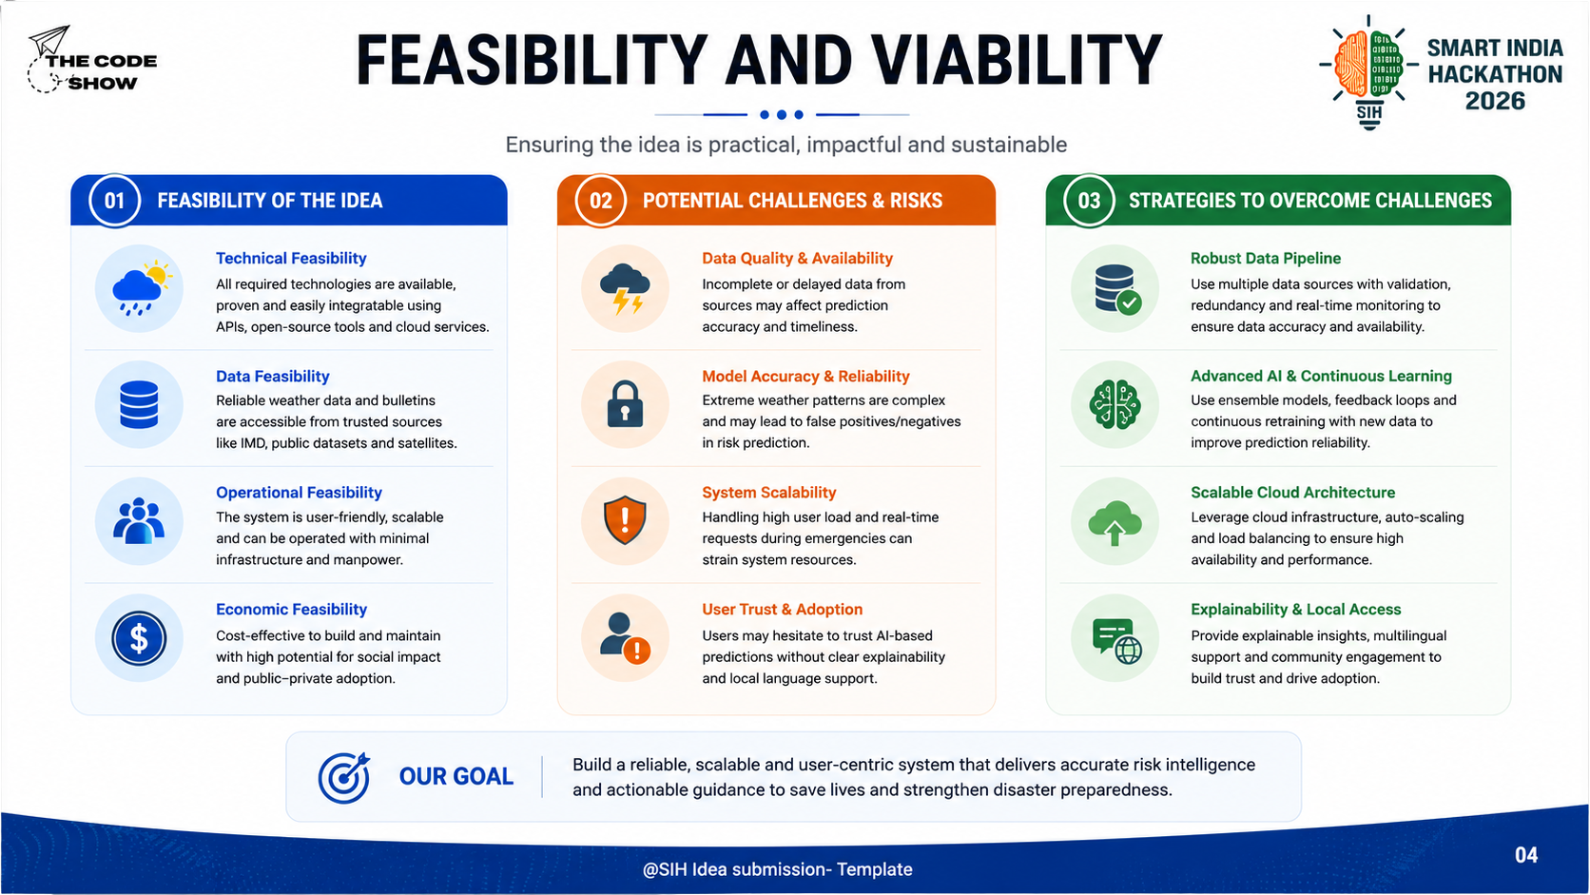
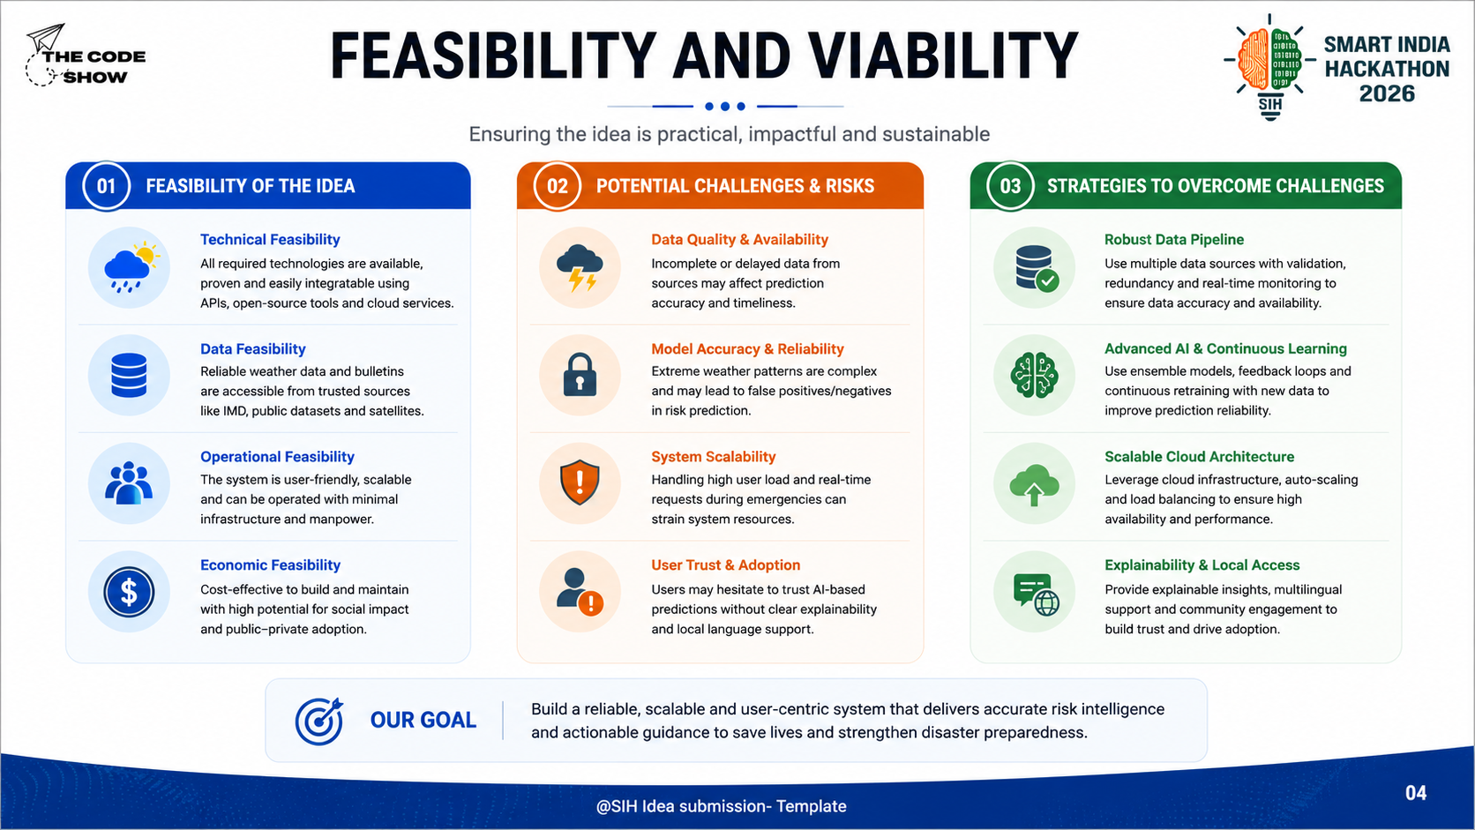
FEASIBILITY AND VIABILITY
@SIH Idea submission- Template
4
Notes:
4

Slide 7
IMPACT AND BENEFITS
Your Team Name
  Potential impact on the target audience
  Benefits of the solution (social, economic, environmental, etc.)
@SIH Idea submission- Template
5
Notes:
5

Slide 8
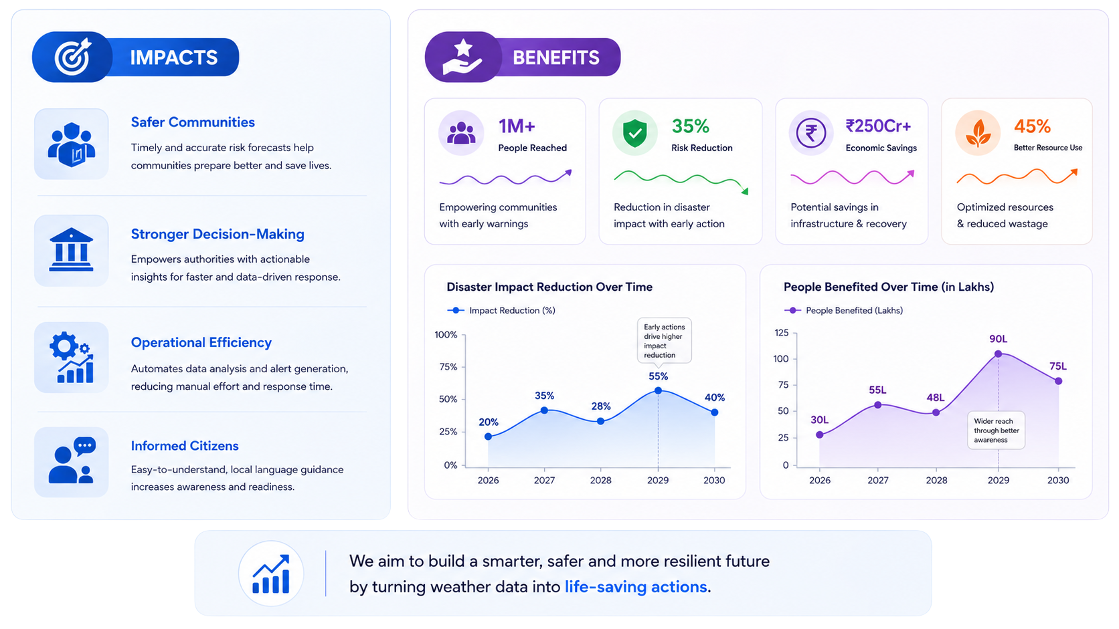
IMPACT AND BENEFITS
BENEFITS
  Safer Communities: Earlier warnings, faster preparedness.
  Smarter Decisions: Real-time risk insights for authorities.
  Inclusive Access: Multilingual, localized AI guidance.
  Lower Losses : Reduced disaster damage & recovery costs.
  Climate Resilience: Better preparedness for future hazards.
  Scalable Impact: One platform across regions & hazards.
@SIH Idea submission- Template
5
Notes:
5

Slide 9
RESEARCH AND REFERENCES
Your Team Name
  Details / Links of the reference and research work
@SIH Idea submission- Template
6
Notes:
6

Slide 10
RESEARCH AND REFERENCES
RESEARCH AND REFERENCES
• Hassan et al., “Machine Learning-Based Rainfall Prediction: Unveiling Insights and Forecasting for Improved Preparedness,” IEEE Access, 2023.
Demonstrates ML-based rainfall prediction for proactive preparedness, supporting our AI risk-prediction layer. (Mendeley)
IEEE Xplore- Research Paper
• “Prediction of Flooding Due to Heavy Rainfall in India Using Machine Learning Algorithms: Providing Advanced Warning,” IEEE, 2022.
Uses ML + rainfall data for flood prediction and advanced warning, directly supporting our impact-based early-warning approach. (ieeexplore.ieee.org)
IEEE Xplore- Research Paper
NEWS / ARTICLES
• India Faces Weakest Monsoon in Nearly Two Decades
Highlights the real-world impact of rainfall variability on agriculture, food prices and rural livelihoods.
Reuters Article
• India’s Capital: Extreme Heat to Heavy Floods
Demonstrates the need for timely, localized weather intelligence and preparedness during rapidly changing extreme-weather events.
Reuters Article
@SIH Idea submission- Template
6
Notes:
6

Slide 11
IMPORTANT INSTRUCTIONS
Please ensure below pointers are met while submitting the Idea PPT:
  Kindly keep the maximum slides limit up to six (6). ( Including the title slide)
  Try to avoid paragraphs and post your idea in points /diagrams / Infographics /pictures
  Keep your explanation precise and easy to understand
  Idea should be unique and novel.
  You can only use provided template for making the PPT without changing the idea details pointers (mentioned in previous slides).
  You need to save the file in PDF and upload the same on portal. No PPT, Word Doc or any other format will be supported.
  Note - You can delete this slide (Important Pointers) when you upload the details of your idea on SIH portal.
@SIH Idea submission- Template
7
Notes:
7

Slide 12
